Slide 1
The Evidence for Contraceptive Options and HIV Outcomes (ECHO) Trial
Jared Baeten MD PhD, University of Washington
on behalf of the ECHO Consortium
WHO Stakeholders’ Meeting on Hormonal Contraception and HIV Lusaka, Zambia, February 2019

Slide 2

















ECHO Team

Slide 3
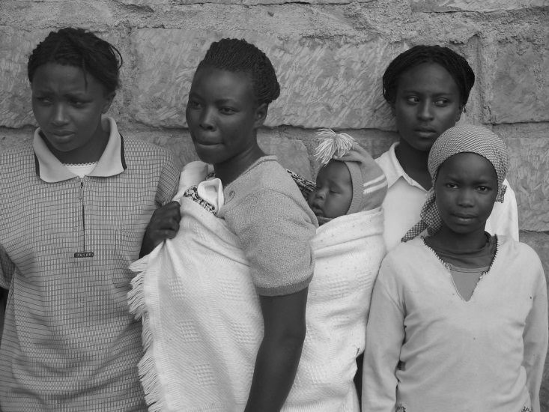
Starting point
Safe and effective contraception is essential to the health and development of women, children and families worldwide

Slide 4
Overlap between injectable hormonal contraception use and HIV prevalence

Slide 5
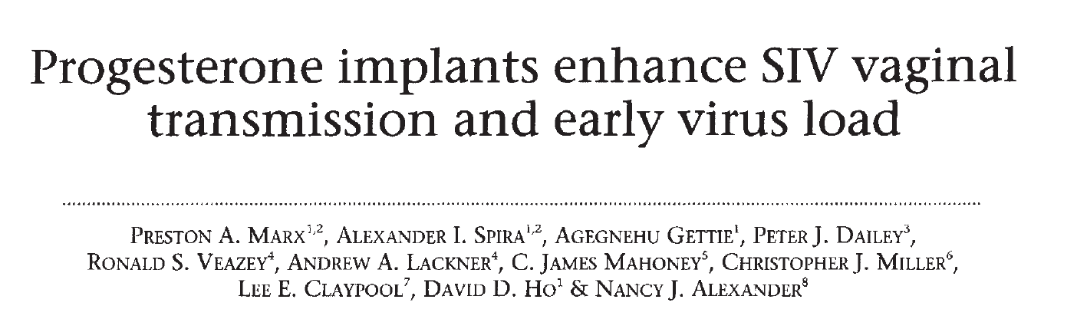
Only observational data have been available
25+ years of epidemiologic and biologic studies have tried to determine whether there is truly increased risk of HIV acquisition associated with use of hormonal contraception.

Slide 6
Summary of evidence
Progestogen-only injectables (particularly DMPA-IM): linked to ↑ HIV risk
  In one meta-analysis, the magnitude of effect was 1.40 (95% CI 1.23-1.59)
  Importantly, we do not know whether DMPA use causes increased risk
  NET-EN: less HIV risk than DMPA? (although limited data)
  DMPA-SC: no data
Hormonal implants & hormonal/non-hormonal IUDs: even less data

Slide 7
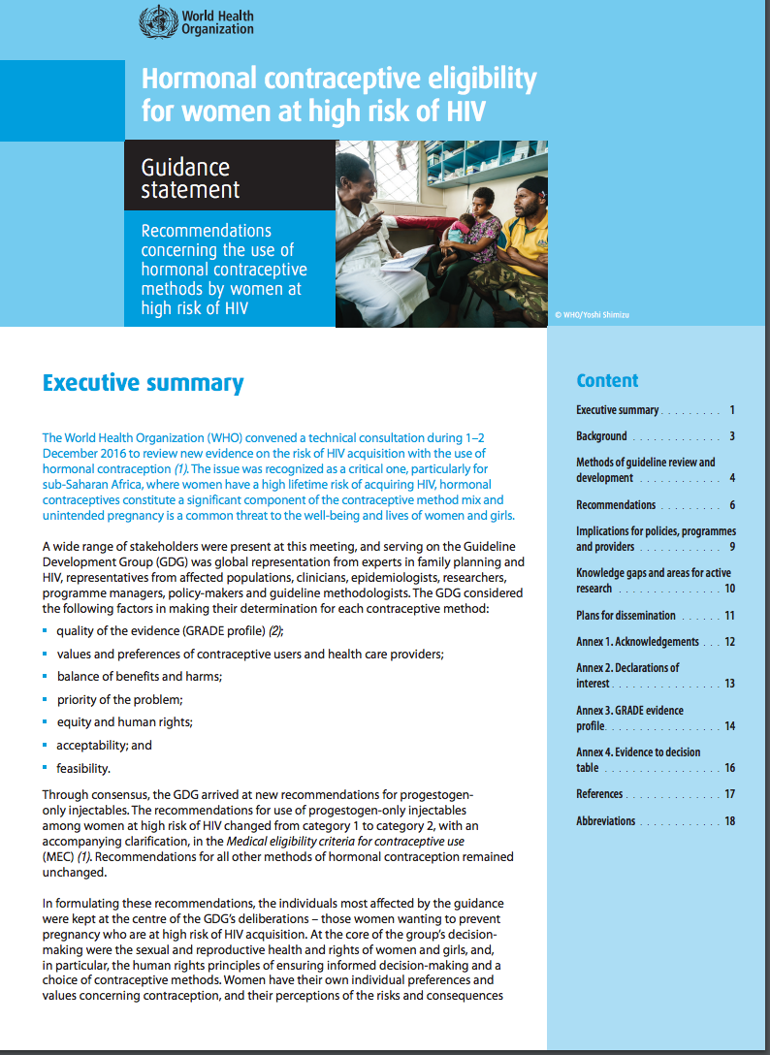
WHO Guidance, 2017
Women can use progestogen-only injectables but should be advised about:
Concerns about possible ↑ risk of HIV
Uncertainty about causal relationship
How to minimize their risk
The WHO guidance also called for data from randomised trials.

Slide 8
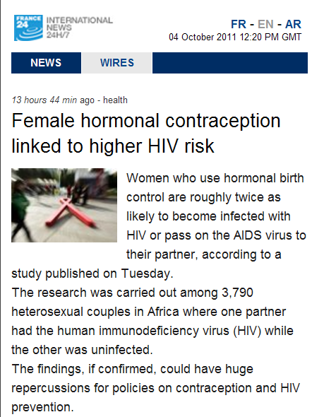
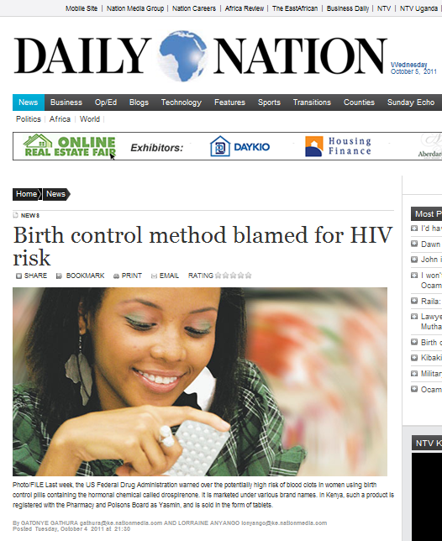
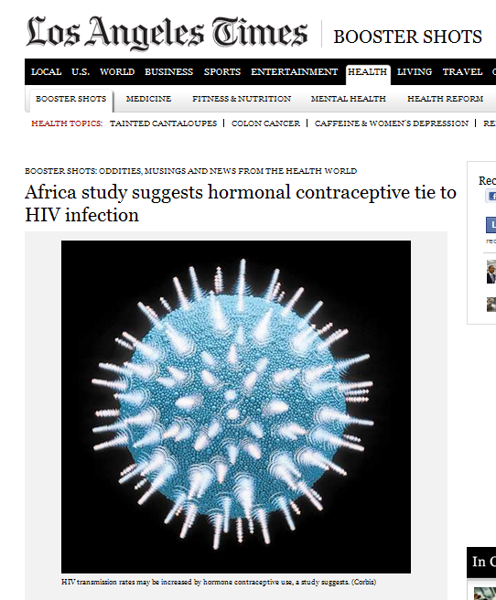
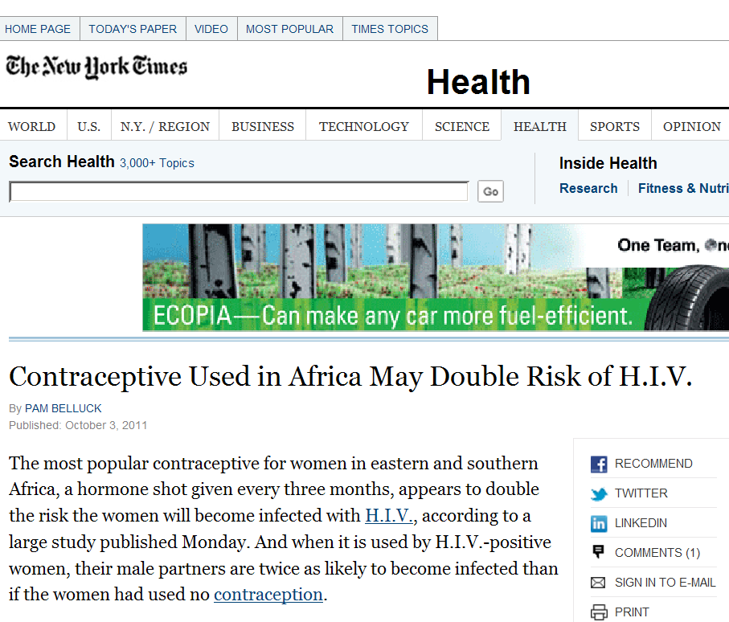
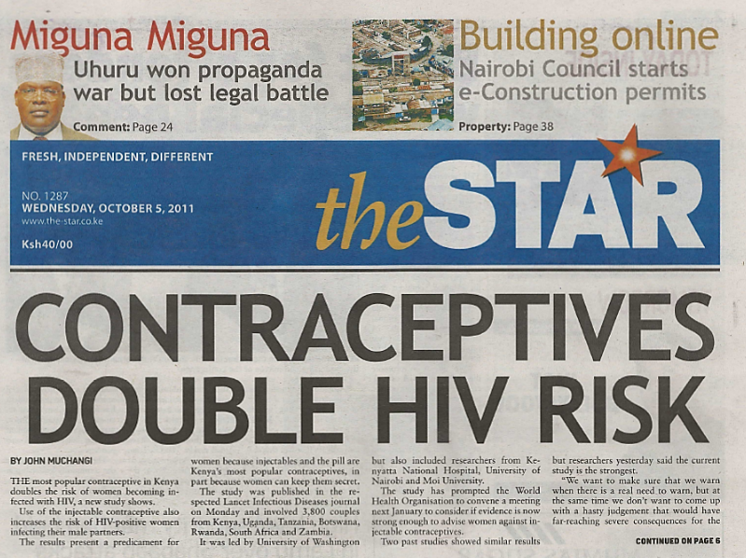
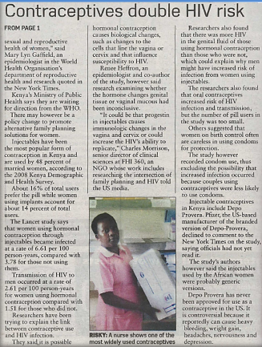
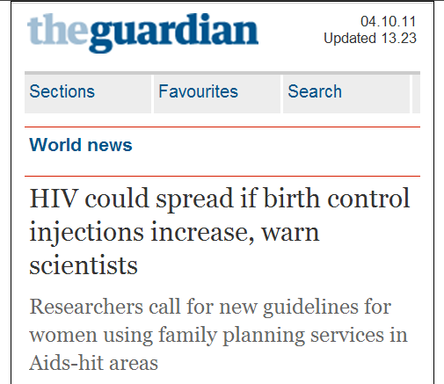
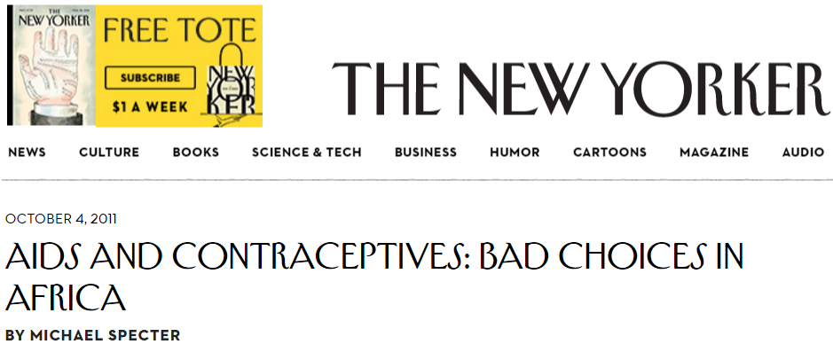

Slide 9
The challenge
Data suggesting HIV acquisition risk with some hormonal contraceptives
Uncertainty in the data
Life-saving benefits of hormonal contraceptives
Public health conundrum

Slide 10
ECHO
A Multi Center, Open-Label, Randomised Clinical Trial Comparing HIV Incidence and Contraceptive Benefits in Women using Depot Medroxyprogesterone Acetate (DMPA), Levonorgestrel (LNG) Implant, and Copper Intrauterine Devices (IUDs)
The Evidence for Contraceptive Options and HIV Outcomes (ECHO) Trial

Slide 11
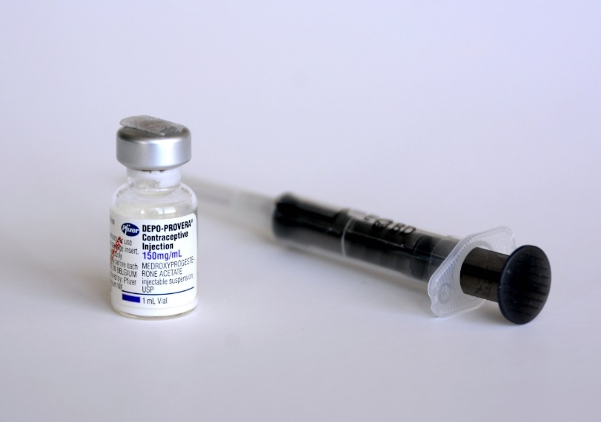
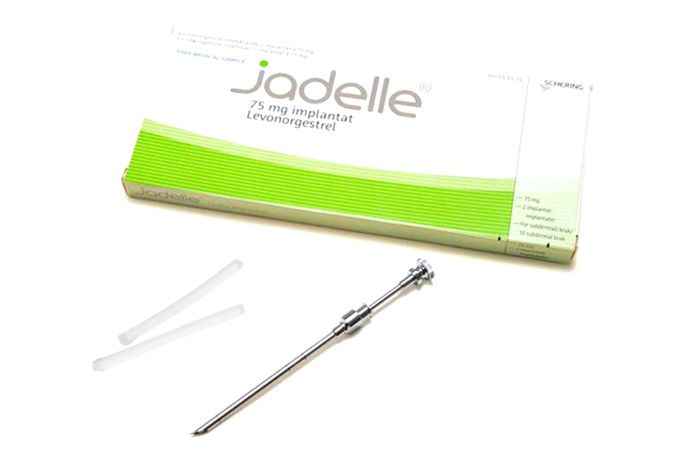
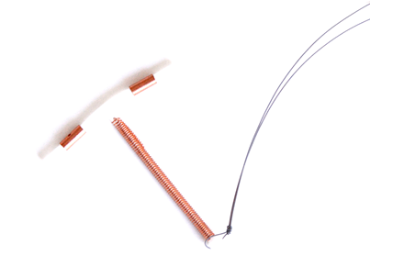
ECHO study goal
To assess whether the risk of acquiring HIV differs with use of three different family planning methods, and how that risk balances against the benefits of those methods
DMPA
Jadelle
Copper IUD

Slide 12
ECHO summary
Design | Multi-center, open-label randomized trial, with random allocation to: DMPA, LNG implant, or copper IUD
Population | Sexually active HIV-uninfected women, ages 16-35 years seeking highly effective contraception, willing & voluntarily consented to be randomly-assigned to any of the three study methods
Sample size | 7,800 women (~2,600 per study group)
Outcomes | Primary = HIV (80% power to observe 50% increase, comparing each method to each of the other two methods) Secondary = pregnancy, safety, method continuation
Duration | Up to 18 months per woman

Slide 13
ECHO study design
7,800 women wanting not to conceive
and willing to be randomised
Randomise
(1:1:1 ratio)
DMPA
(2,600 women)
LNG implant
(2,600 women)
Copper IUD
(2,600 women)
3-monthly visits for up to 18 months
Primary Endpoint: HIV Infection
Secondary Endpoints: Pregnancy, Safety looking at serious side effects (adverse events), Method continuation

Slide 14
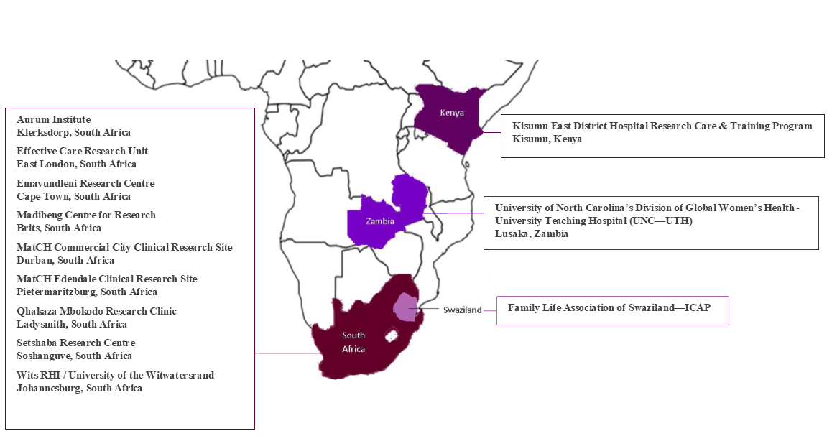
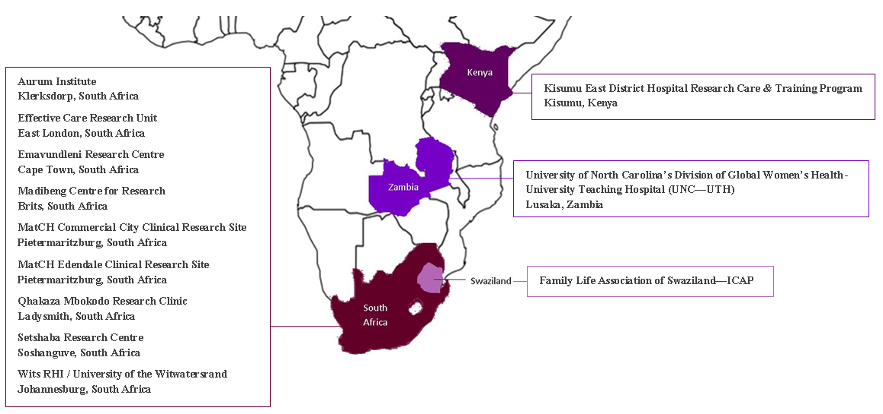
Study setting: 12 sites in 4 countries

Slide 15
Why a randomized study?
Only a randomize clinical trial can evaluate for evidence of causal relationship – i.e., that using a particular contraceptive method leads to increased risk of HIV
A randomized trial will provide the highest-quality evidence to:
  Enable women to make fully informed choices
  Inform clear counselling messages for clinicians
  Offer guidance for policymakers and programs

Slide 16
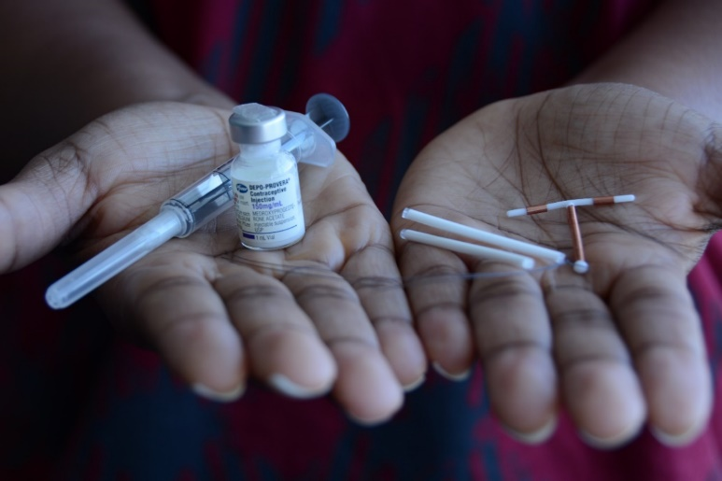

What ECHO will contribute
The highest quality scientific evidence on the question of hormonal contraception and HIV risk
Needed information for women, so they can make informed choices about contraception and HIV prevention

Slide 17
ECHO visits
Study visits at one month, then quarterly for up to 18 months:
  HIV testing and contraceptive counselling
Women receive comprehensive contraceptive and HIV prevention package:
  Counselling
  Condoms
  Offer of partner HIV testing
  STI screening and treatment
  Offer of oral PrEP (introduced during study as national policies allowed)

Slide 18
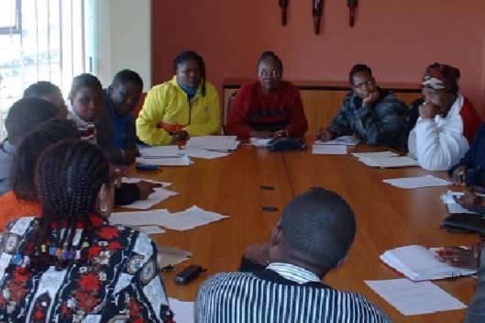
ECHO oversight
Ethics committees and qualified independent clinical monitors
A safety oversight committee, available 24/7 for clinical advice
Global Community Advisory Group and
Community Advisory Boards (CAB) at each site
Good Participatory Practice plans for each site
An independent Data and Safety Monitoring Board
Local CAB meeting to hear updates on ECHO Study
Notes:
Ethical review of protocol prior to start and annually by ethics committees
International quality control and assurance standards and review by qualified independent clinical monitors
Monthly review of safety data by a safety oversight committee available 24/7 for clinical advice
A Global Community Advisory Group and CABs at each site met regularly. Each site has an active Good Participatory Practice plan.
An independent DSMB reviewed data on participant safety, study conduct, and scientific validity and integrity of the trial about every 6 months.

Slide 19


ECHO progress
7,830
Women enrolled
100%
Enrolment target reached and follow-up visits completed as of
31 October 2018
Mid–2019
Study results expected

Slide 20
We do not yet know the results, but…

Slide 21
ECHO: What can the study tell us?
HIV incidence: comparison of how many women became HIV infected in each group
DMPA vs. IUD | Implant vs. IUD | DMPA vs. Implant
Studies of possible biologic mechanisms (ancillary studies to ECHO)
Direct comparison of how many women decided to stop using the contraceptive method they were assigned during & at the end of the study
Comparison of how many women became pregnant in each contraceptive group

Slide 22
ECHO: What it cannot tell us
HIV risk
  Compared to no contraception (because we did not have a control group of women not using contraception)
  For methods not tested (e.g., COCs, NET-EN, DMPA-SC, ETG implant, progestin IUS, etc.)
Differences in HIV risk between methods smaller than an approximately 35% increase
Importantly: ECHO will provide evidence — not prescriptions — for policy, program, and individual decision-making
Notes:
ECHO will provide evidence — not prescriptions — for policy, program, and individual decision-making

Slide 23
Thinking through some possible ECHO outcomes
No difference in HIV risk, with similar HIV incidence for the three groups (DMPA=implant=IUD)

Slide 24
Thinking through some possible ECHO outcomes
Difference in HIV risk, with DMPA ≥1.5-fold greater HIV incidence than implant and/or IUD
→ The ECHO trial is designed with high statistical power to detect at least a 50% increase in HIV risk
→ The observational data suggest DMPA could have a ~40-50%, or greater, increased HIV risk

Slide 25
Thinking through some possible ECHO outcomes
Difference in HIV risk, but DMPA <1.5-fold greater risk than implant and/or IUD
→ The trial is designed with high statistical power to detect at least a 50% increase in HIV risk.
→ However, under that statistical power consideration, an HIV risk difference of at least ~35% will be statistically significant.

Slide 26
Thinking through some possible ECHO outcomes
Difference in HIV risk, with highest HIV incidence for IUD or implant
→ While this might be a surprising result, remember that there are currently very few data to assess HIV risk for implants and IUDs.
→ ECHO is designed to have statistical power to detect at least a 50% increased HIV risk for any of the methods, compared to each of the other two methods.

Slide 27
What’s next
Data analysis is ongoing
Results dissemination estimated in mid-2019
Results presented to WHO Guidance Steering Group, who will consider new data and whether there is need for policy change

Slide 28






ECHO Funders
Contraceptive supplies donated by USAID and the Republic of South Africa

Slide 29
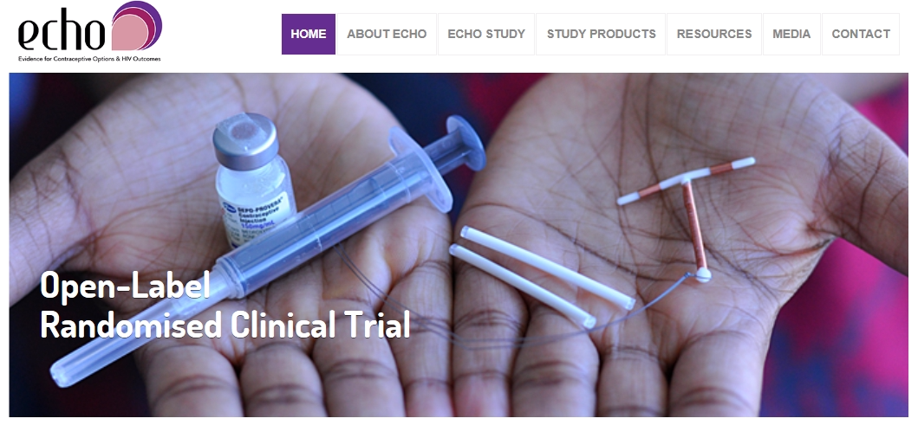
Website - www.echo-consortium.com

